Slide 1
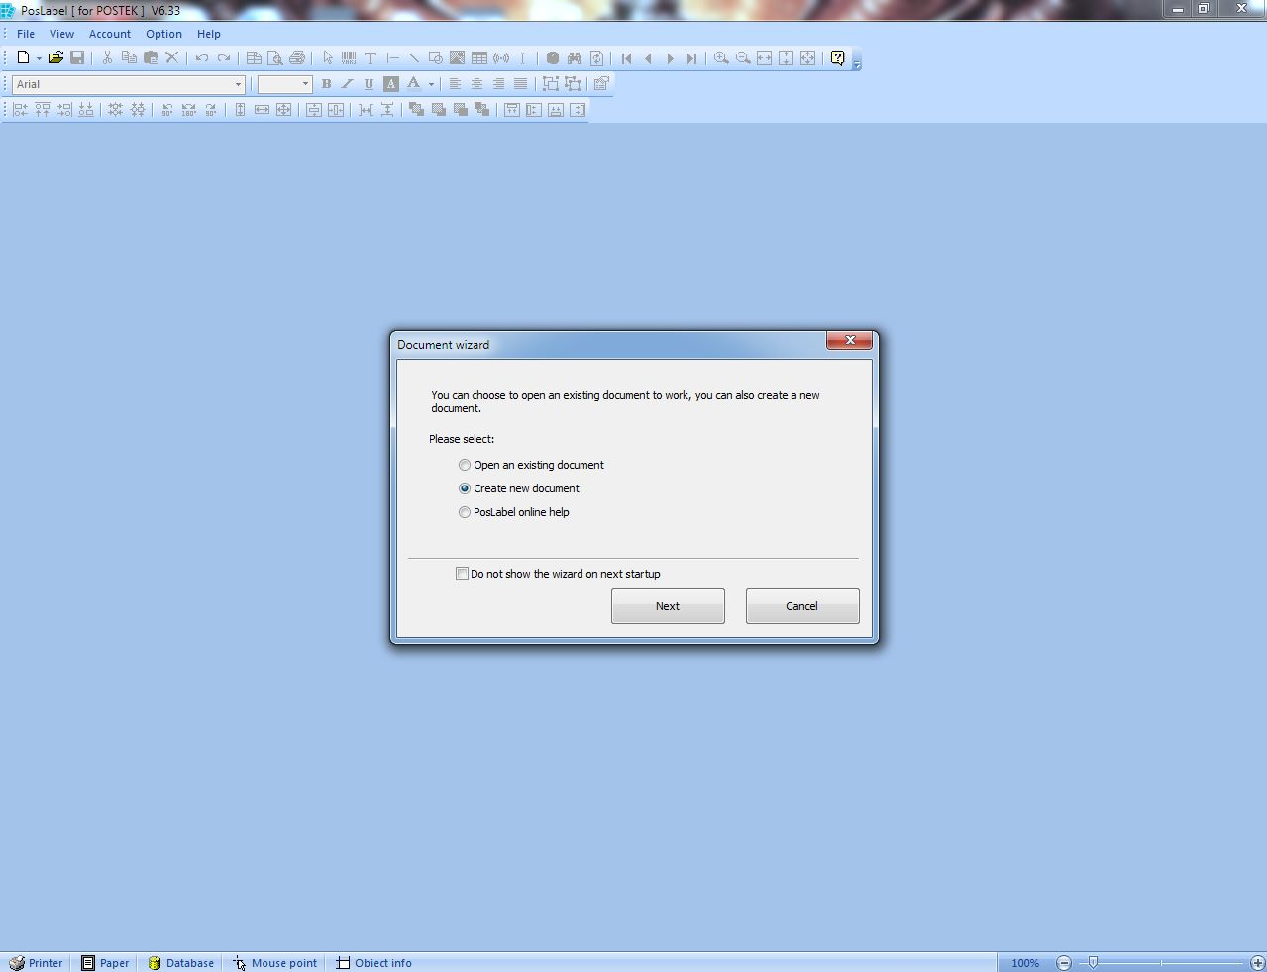
Label Software
Open the File menu.
Click Open to open an existing document.
Click New Document to create a new label design.

Slide 2
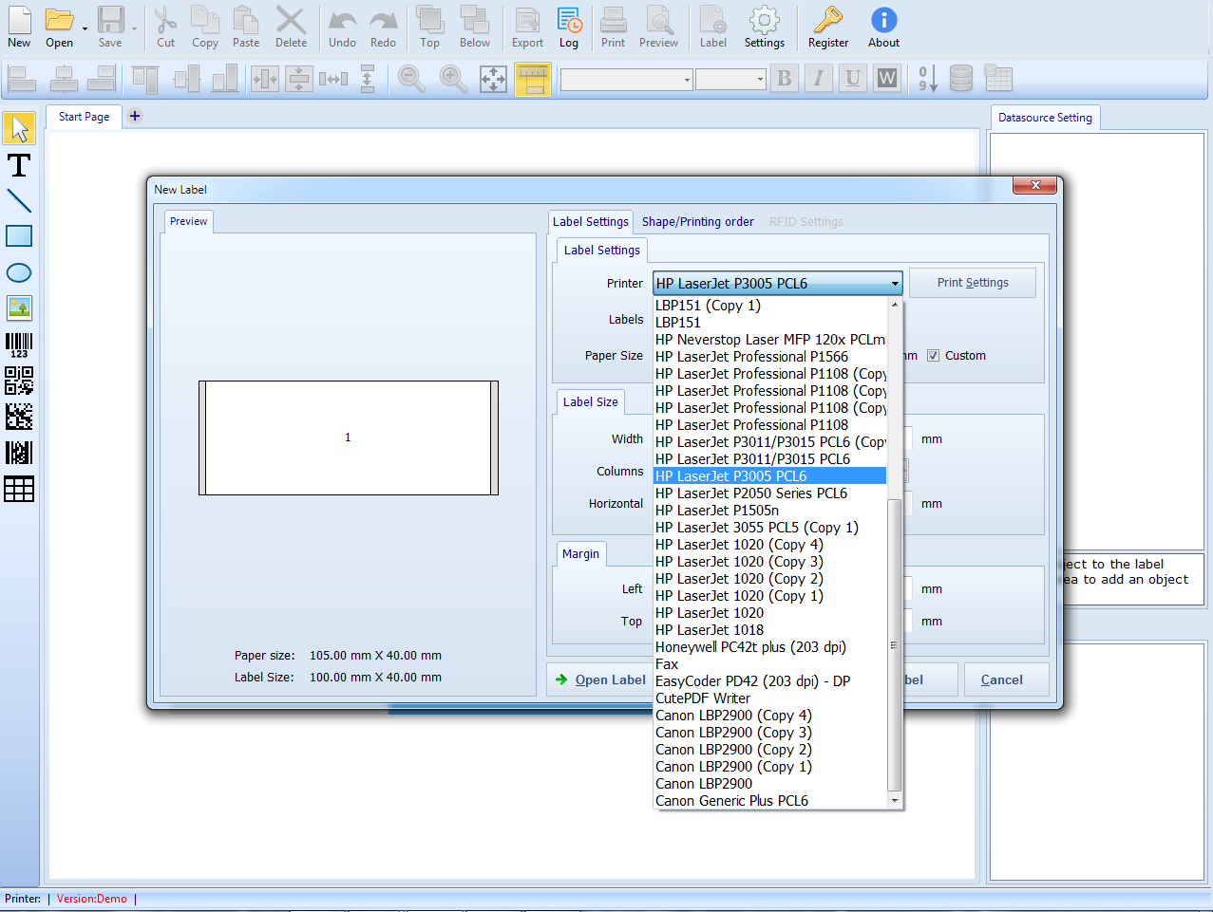
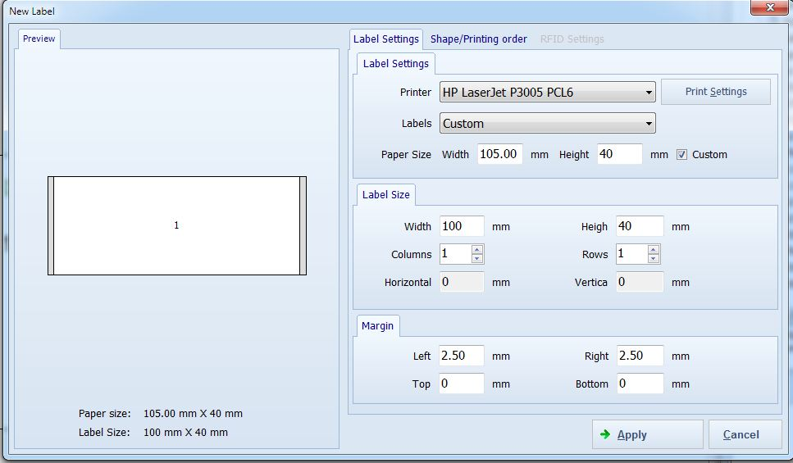
Label Setup
Click the Label Icon.
Enter the Label Width and Label Height manually.
Set the Horizontal Gap and Vertical Gap manually (default value is 3.00 mm).
Enter the Layout Columns and Rows manually.
Select the Shape of the label:
Round Rectangle
Square Rectangle
Ellipse (3 options available)

Slide 3
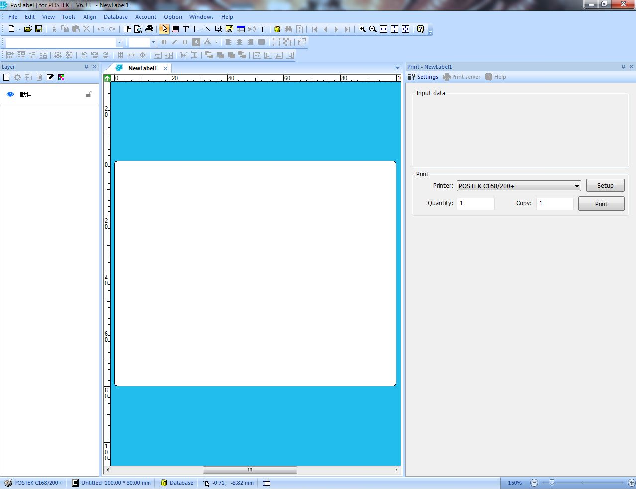
Blank Page
After entering the label size, click OK.
The system will open a Blank Page for label design.

Slide 4
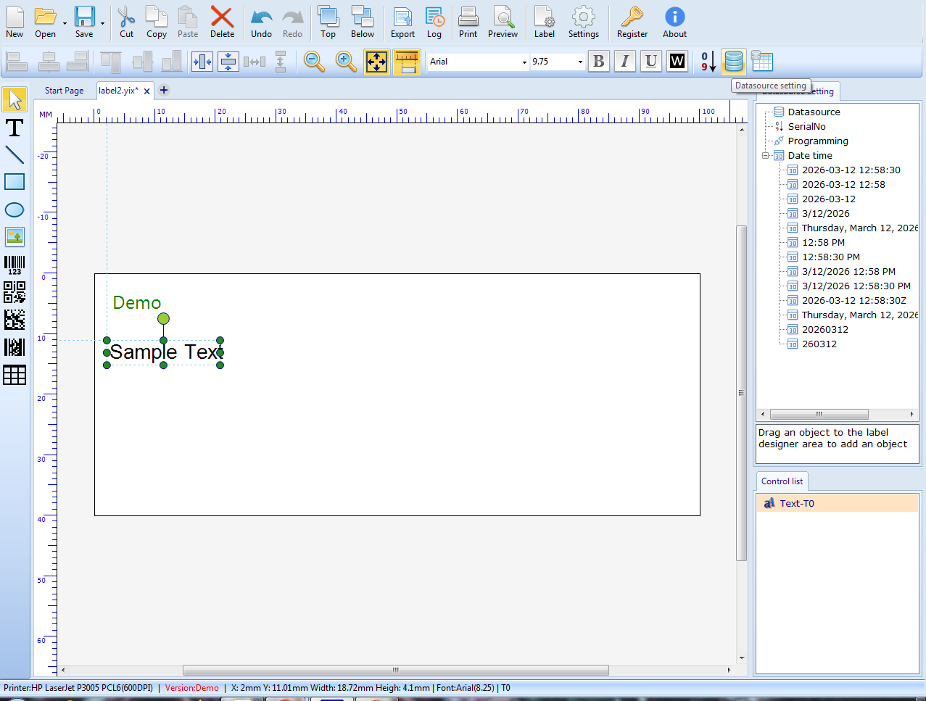
Select the Data Base
At the Right of the page, click the Database option.
Then select Setup Database.

Slide 5
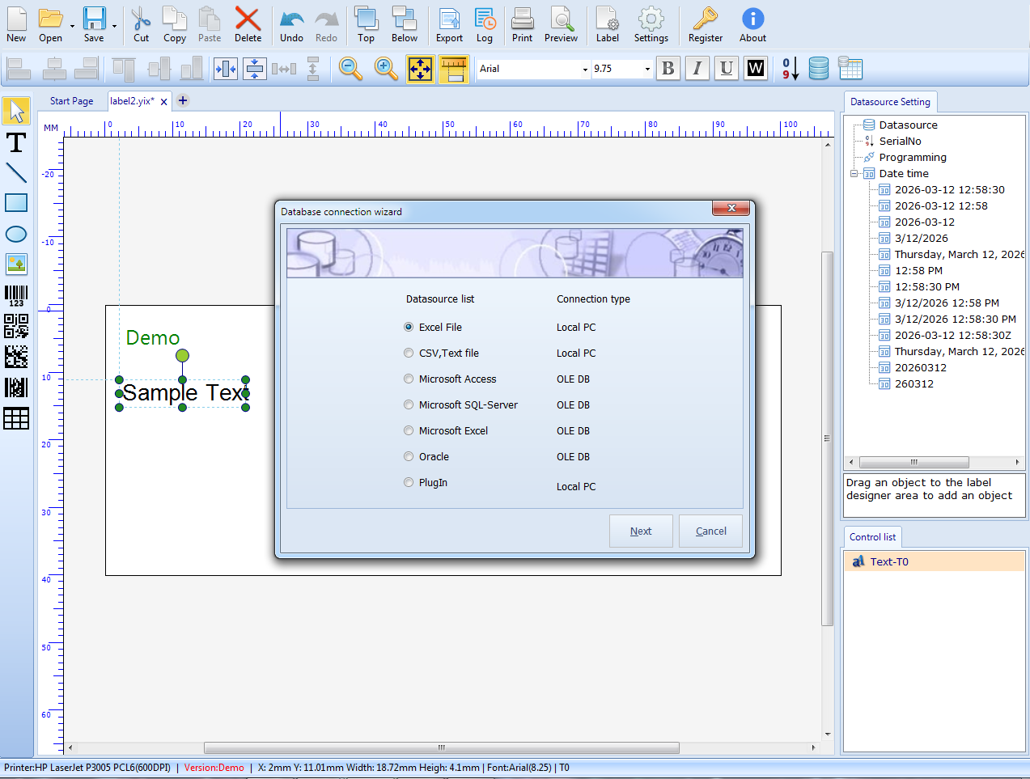
Database Select File
Select the File Type as Excel File.
Click Select File.
A browser window will open to choose the Excel file from the local disk.
After selecting the file, a preview of the Excel data will be displayed at the bottom of the window.

Slide 6
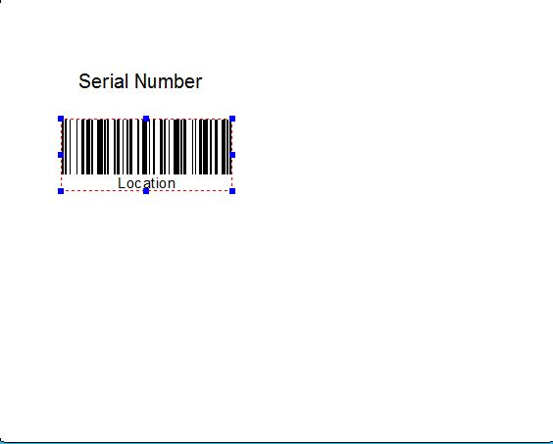
Insert The Text
At the top of the page, click the Text (T) Symbol.
There are three types of text options:
Normal Text
Multiple Text
Wrap Text
Select Normal Text.
Click and drag on the page to place the text.
A text settings popup window will open.
At the top of the page, the Barcode Symbol is also available to insert barcodes.

Slide 7
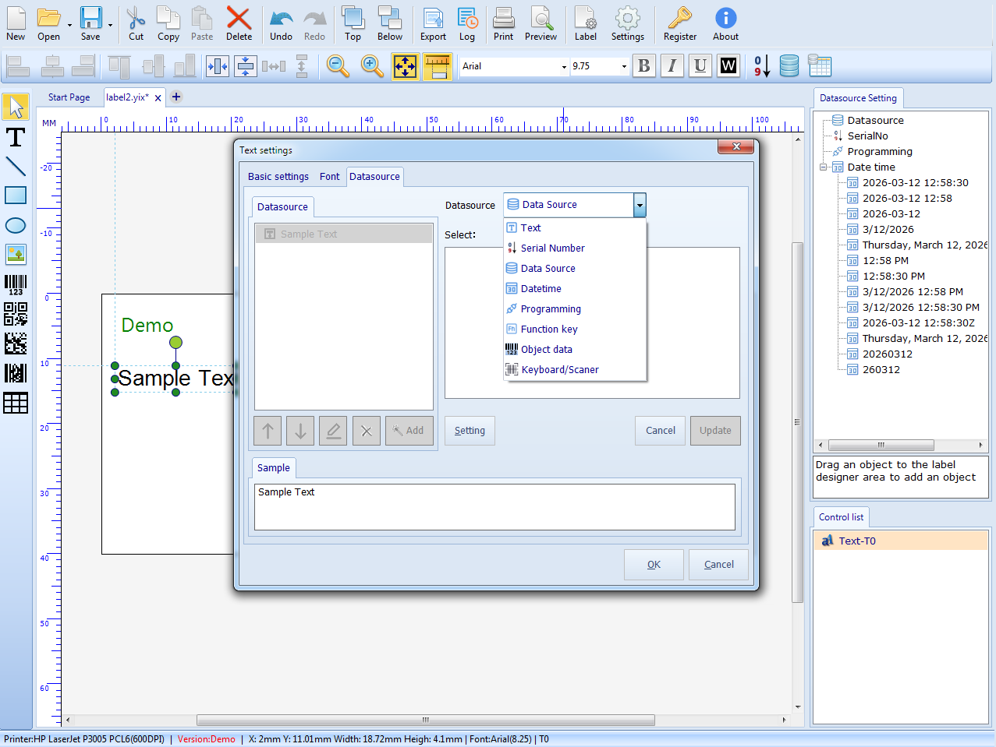
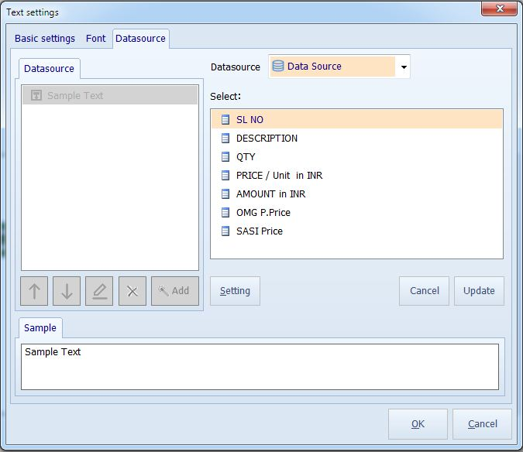
Database Merge
Click Source to select the data source. There are 6 types available:
Fixed
Database
Date
Time
Keyboard
Serial Number
Select Database. The field names from the Excel sheet header will automatically appear.

Slide 8
Barcode Type
Left Side Barcode Symbol is there.
Choose the Barcode 1D or 2D.
Select the required Excel field for the barcode value.
If Serial Number is selected, the last number will automatically increment.

Slide 9
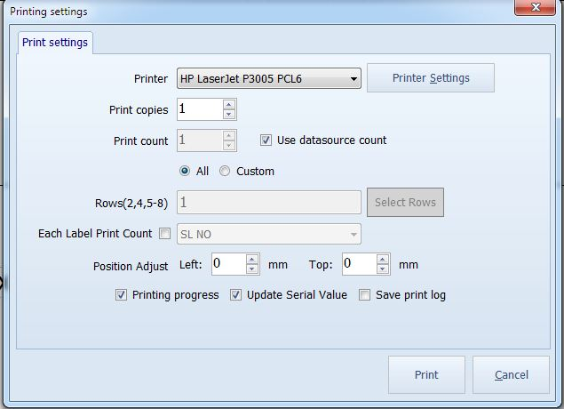
Print Option
Press Ctrl + P to open the Print Page.
In Print Range, enter the Quantity manually.
Two options are available:
All
Custom
If Rows (2,4,5-8) enter the Excel Serial Number (S.No) to print.
Total Record Value will display the number of records in the Excel sheet.
Start Record is automatically set to 1, but it can be changed.
Enter the Number of Copies manually.

Slide 10
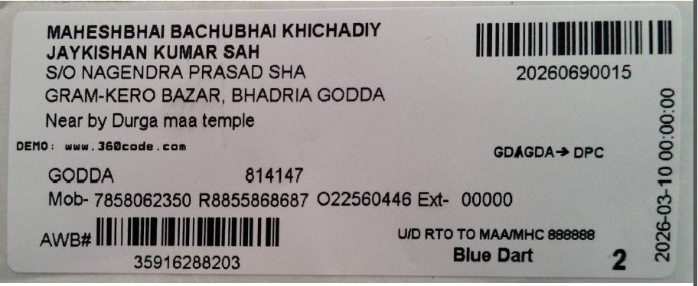
Label Output
The final label output will be printed using the barcode printer.

